Slide 1

Gaming Grant 101
PAC Executive Training
Contact: dpac.sd34@gmail.com

Slide 2

Gaming Grant Purpose
PAC:
PAC grant funding is intended to benefit students by enhancing extracurricular opportunities of students who attend the school represented by the PAC.
DPAC
DPAC grant funding is intended to foster greater parental involvement in schools and effective communication between schools, parents, students and the community.

Slide 3
PAC – DPAC Eligibility
PACs or equivalent groups at public schools, group 1 or 2 independent schools, and First Nation band schools
Separate from the management and operation of the school & composed of parents or guardians of students attending the school
Not-for-profit – do not need to be registered
Open membership for parents/guardians of students attending the school
Provide extracurricular programming that is accessible and inclusive for all students
Democratically chosen volunteer executive
In operation for at least 12 months

Slide 4
Funding Allocation
PAC:
Receive $20 per student, per year based on the pervious September enrollment
DPAC
Receive $2,500 each
Schools with fewer than 100 students will be provided a base rate of $2,000.

Slide 5

How to apply
Check your reporting history
Ensure that your PAC is up to-date filing the Gaming Account Summary Reports
Have your BCeID ready
Have your login details for the BCeID ready. If not, apply online for your free BCeID.
Prepare your documents
New PACs have to provide their constitution & bylaws and AGM minutes. These should be provided if changes occur.
Apply online
To complete your application, click the Apply Now button and follow the steps. Have your L&G number ready to retrieve your account information.
Save and complete your application
Save your progress, and once complete, submit your application. You can also print a copy for your records.

Slide 6
Before you apply
NEW PACs /first time applicants:
PAC/DPAC information, including constitution and bylaws, AGM minutes
Annually (have on-hand):
• L&G number from past decision letter to prepopulate the form
• A complete list of annexes/ school(s) that the PAC/DPAC represents
• Names, positions and contact information of 2-4 members of the PAC/DPAC responsible for the application
• Ensure recent Gaming Account Summary Report(s) have been submitted
• A dedicated bank account to receive the grant “Gaming Account” and the Direct Deposit Application form (FIN 312) is needed for new applicants and those who have not received funding in the past 12 months (April 2024 – March 2025)

Slide 7
Tips and Advice for Applying
Subscribe to Community Gaming Grants’ “News & Updates” webpage to receive reminders and updates.
Read the most recent PAC/DPAC Guidelines
Review the Preapplication checklist
Phone a help line, if needed. Someone available every business day
Review the Application Tutorial
Ensure your Gaming Account Summary Reports are submitted
Apply on time. It is highly unlikely that late applications will be funded.

Slide 8
Eligible Expenses - PACs
Field trips within B.C.
Presentations or performances (e.g. music, theatre, science).
PAC school spirit and family engagement events (e.g. school carnivals, movie nights, school dances, other social activities).
Entertainment or leisure activities for non-instructional times (e.g. graphic novels/comics, magazines, extracurricular fiction and non-fiction books, board games, colouring books).
Student publications (e.g. newsletters, yearbooks).
Student competitions (e.g. writing, debating, chess, music).
Student computers for extracurricular activities/clubs (e.g. software, hardware, accessories for photography club, robotics club, yearbook club).
Student clubs or societies (e.g. drama club, chess club).

Slide 9
Eligible Expenses - PACs
Student ceremonies (e.g. graduation, dry grad).
Team or club uniforms (e.g. jerseys, t-shirts) and/or equipment for extracurricular activities.
Equipment for extracurricular sports.
Items that directly benefit students (e.g. playground equipment or enhancements).
Student recognition (e.g. certificates, trophies, grad memorabilia).
Student conferences within B.C.
BCCPAC membership fees.
Fees or travel/accommodation costs incurred to travel to the BCCPAC annual conference
Emergency, safety or earthquake related supplies or equipment that is not ordinarily the responsibility of the school/school district.
With prior approval, student transportation and travel outside of B.C

Slide 10
Eligible Expenses - DPAC
Informational and promotional materials for parents (e.g. newsletters, websites, social media, etc.)
Administrative costs (e.g. meeting room rental, printing costs, presenter/guest speaker fees, etc.).
Parent training and workshops (e.g. Foodsafe, student health or wellness classes, Robert’s Rules for Boards, etc.)
British Columbia Confederation of Parent Advisory Councils membership fees for the DPAC only.
Travel for regular DPAC meetings.
Fees or travel/accommodation costs incurred to travel to the BCCPAC annual conference

Slide 11
Ineligible Expenses – PAC/DPAC
Curricular activities or items (e.g. instructional materials, textbooks.
Items used primarily in the classroom to assist in the delivery or completion of curriculum (e.g. tablets, smart boards).
Grant funds may not be used for any fundraising components at PAC events (e.g. the sale of goods/services to generate revenue).
Out-of-province travel, unless approved by the Branch.
Replacing/repairing school facilities that are the responsibility of the school/school district (e.g. structural repairs, water refill stations, school infrastructure).

Slide 12
Ineligible Expenses – PAC/DPAC
Items that are the responsibility of the school/school district (e.g. audio-visual equipment, digital news boards, PPE).
(PACs-only): Goods and services that benefit the parents (e.g. parent education, parent workshops).
Administrative and/or operational costs incurred to support the PAC (e.g. office supplies and equipment, accounting or insurance fees).
Costs related to paid staff, teachers on call, education assistants (e.g. luncheons, wages, travel, training/professional development).
Monetary prizes or gift cards
Financial assistance, monetary support, donations, or items/services purchased on behalf of other organizations or individuals
Past debt (i.e. previous fiscal year expenses), loans, or interest payments.
Scholarship and bursaries

Slide 13

Spending Timeline
PACs: Grant funds must be spent within 24 months of receipt.
DPACs: Grant funds must be spent within 12 months of receipt.
Grant funds can back-pay expenses incurred in the same fiscal year the grant is received.
This is done by transferring funds from the Gaming Account to the General Account for previously incurred eligible expenses. You cannot pay past debt or future costs not yet incurred.

Slide 14
Spending Rules
Grant funds are deposited into an organization’s “Gaming Account
All eligible expenses should be paid directly from the Gaming Account. Grant funds may be transferred – by cheque or electronically – from the Gaming Account to the General Account for the reimbursement of eligible program expenses.
Method of payment - Cheque or board-approved electronic transfer.
Documentation - Invoices and receipts must be retained for five years.

Slide 15
Financial Reporting
All Gaming Grant spending must be reported in the “Gaming Account Summary Report (GASR)
All organizations that receive Community Gaming Grants or have previously received a grant and still have money in their Gaming Account, must submit a GASR.
Must be submitted within 90 days of the organization’s fiscal year end (do not submit prior to FYE)
The GASR details: “Gaming Account” balance at beginning of fiscal year; grants received; funds disbursed; and balance at end of fiscal year.
GASR also requires a description of how the funding benefited the community – ie. students.

Slide 16
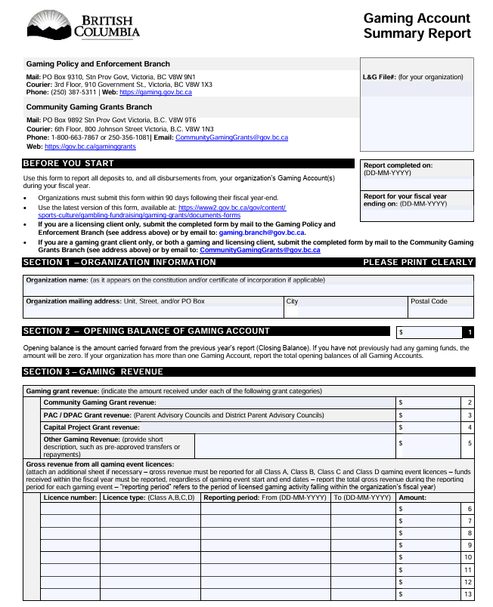
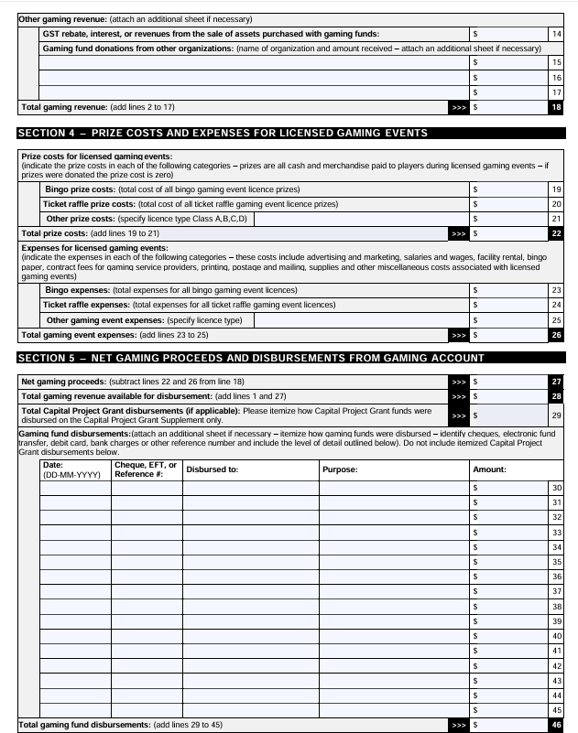
Sample Gaming Account Summary Report

Slide 17
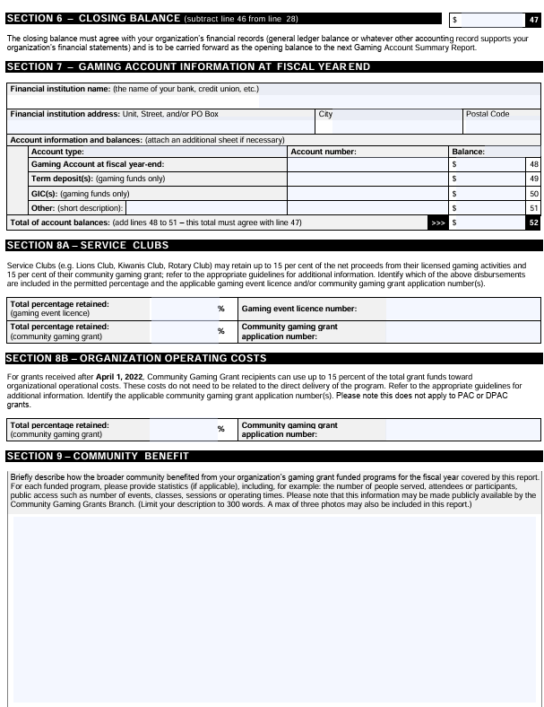
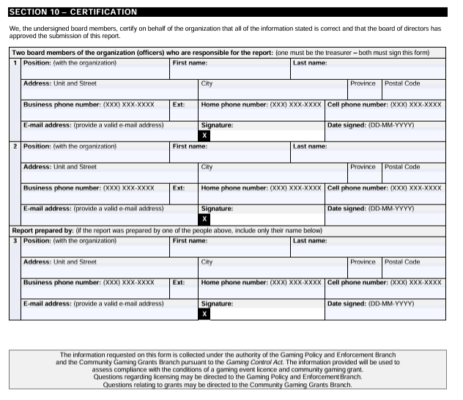
Sample Gaming Account Summary Report

Slide 18
Capital Project Grant
Capital projects with a total cost between $20,000 - $1,250,000
Between 20% and 50% of the total cost of a project may be funded Grants up to $250,000 (max)
Matching funds are required
$5M Annual Funding
Competitive Process
Application intake period June – August
Notifications: December 31
One application per year, only one grant per project
You can still apply for your Community Gaming Grant

Slide 19
Project Eligibility
Facilities– construction of new facilities; renovation or maintenance of existing facilities Purchase new/used buildings, community or childcare facility, recovery house, interior or exterior renovation (kitchen/bathroom/flooring/roof); HVAC system, elevators, tennis bubbles, lighting, curling club refrigeration.
Community Infrastructure– development of public amenities that improve B.C. residents’ quality of life Playgrounds, outdoor structures, community space, skate park, hiking/walking trails, public wharf, ecosystem restoration.
Acquisitions– purchase of fixed capital assets for long-term ownership and use by the applicant organization Vehicles, buses/vans, computer systems, office or technical equipment, audio/visual equipment, sports equipment, boats.

Slide 20
Competitive Scoring Process
Community benefit (20%)
Inclusiveness and accessibility (5%)
Project Feasibility (25%)
Financial Considerations (45%)
Financial Considerations (45%)

Slide 21
Gaming Licences
All gambling events in BC require a licence – A, B, C or D
Licences must be applied for and approved before the start of the event. All applications must be filed online. Class A and C require a minimum 10 week processing time. Class B and D require a minimum 10 day processing time
Type of licence applied for depends on the event and the maximum amount of money to be raised
Each event requires a separate licence
Each licence requires a Gaming Event Revenue Report to be filed at the completion of the event. Report is due 90 days after expiry of licence
All gaming proceeds must be deposited into the gaming account
Running a gambling event without the required licence will run you the risk of losing your gaming funds

Slide 22
Key Resources and Contacts
  Community Gaming Grants Branch (CGG)
  • Website: https://gov.bc.ca/gaminggrants • General Questions: communitygaminggrants@gov.bc.ca
  • Phone: 250-356-1081
  Confederation of Parent Advisory Councils (BCCPAC)
  • Website: https ://bccpac.bc.ca/
  • Email: info@bccpac.bc.ca
  British Columbia Association of Charitable Gaming (BCACG)
  • Website: https ://bcacg.com
  • Email: gamingquestions@bcacg .com
  • Chilliwack – Fraser Valley CCGA https://fraservalleyccga.ca/

Slide 23
Frequently Asked Questions
Q: Can a PAC give grant funds to the school or school district?
A: No. Per section 10 of the Conditions for a PAC/DPAC Grant, PACs are not permitted to make advances or donations of gaming funds to a school or school district.
However, the PAC may reimburse the school, school district, school group, or an individual for eligible disbursements as long as supporting documentation is retained in the PAC's gaming records.
It is preferred that the PAC pays suppliers of goods and services directly whenever possible.

Slide 24
Frequently Asked Questions
Q: How do PACs make capital purchases? Does the PAC or the school own the asset?
A: PACs should not be making purchases for the school/school district and should retain management and control over any assets purchased using PAC grant funds.
Instances where the ownership of eligible assets are transferred over to the school or school district for storage, maintenance, operation, or liability insurance purposes is acceptable, but should be agreed to in writing. PACs should seek any necessary permissions or permits required from their school, school district and/or city prior to making purchases for any projects that require installation or which take place on school grounds. Installation fees should be paid for by the school/school district and/or city.

Slide 25
Frequently Asked Questions
Q: Why can’t our PAC use funds for scholarships and bursaries?
A: Using funds for scholarships and bursaries does not align with the intentions of the CGG PAC grant funding. The funding should benefit as many children as possible and provide opportunities for extra-curricular activities for students currently attending the school.

Slide 26
Frequently Asked Questions
Q: Can we purchase playground equipment?
A: PACs can use their funding to purchase playground equipment. If there are modifications to the school grounds (e.g. levelling of ground, digging) required to install the equipment, this would fall under the school’s responsibility.
PACs may retain their PAC grant funding for up to 24 months, so there are PAC groups that save this funding to make a larger purchase, such as a playground.
PACs may also apply to the Capital Project Grant program for funds for a playground; however, playgrounds located on public school grounds that are eligible for the Ministry of Education’s Playground Equipment Program (PEP) are not eligible for a Capital Project grant. School Districts are responsible for applying for the PEP; confirm with the SD if your project is eligible for the PEP.

Slide 27
Frequently Asked Questions
Q: What happens if my PAC applies for a grant after the intake closes on June 30?
A: It is highly unlikely for a late application to receive funding. CGG receives over 5,000 applications to the program each year and will prioritize funding those applications submitted on-time. The ability to provide funding to late applications is subject to the overall availability of funding. As the CGG program is often oversubscribed with funding requests that extend beyond the $140 Million budget, it is highly unlikely that there would be enough money left to fund late applications.

Slide 28
Questions?
Contact: communitygaminggrants@gov.bc.ca
Thank you for serving your PAC!

