Slide 1


Gaming Grant 101
PAC Executive Training
Contact: dpac.sd34@gmail.com

Slide 2

Gaming Grant Purpose
PAC:
PAC grant funding is intended to benefit students by enhancing extracurricular opportunities of students who attend the school represented by the PAC.
DPAC
DPAC grant funding is intended to foster greater parental involvement in schools and effective communication between schools, parents, students and the community.

Slide 3
PAC – DPAC Eligibility
PACs or equivalent groups at public schools, group 1 or 2 independent schools, and First Nation band schools
Separate from the management and operation of the school
Not-for-profit – do not need to be registered
Open membership for parents/guardians of students attending the school
Provide extracurricular programming that is accessible and inclusive for all students
Democratically chosen volunteer executive
In operation for at least 12 months

Slide 4
Funding Allocation
PAC:
Receive $20 per student, per year based on the pervious September enrollment
DPAC
Receive $2,500 each
Schools with fewer than 100 students will be provided a base rate of $2,000.

Slide 5
How to apply
Check your reporting history
up to-date filing of the Gaming Account Summary Reports
Have your BCeID login ready
If not, apply online for your free BCeID.
Prepare your documents
New PACs have to provide their C&B and AGM minutes.
Apply online
Have your L&G number ready to retrieve your account information.
Save and complete your application

Slide 6
Before you apply
Annually (have on-hand):
• L&G number from past decision letter to prepopulate the form
• A complete list of annexes/ school(s) that the PAC/DPAC represents
• Names, positions and contact information of 2-4 members of the PAC/DPAC responsible for the application
• Ensure recent Gaming Account Summary Report(s) have been submitted
• A dedicated bank account to receive the grant “Gaming Account” and the Direct Deposit Application form (FIN 312) is needed for new applicants and those who have not received funding in the past 12 months (April 2024 – March 2025)

Slide 7
Tips and Advice for Applying
Subscribe to Community Gaming Grants’ “News & Updates”.
Read the most recent PAC/DPAC Guidelines
Phone a help line, if needed.
Ensure your Gaming Account Summary Reports are submitted
Apply on time. It is highly unlikely that late applications will be funded.

Slide 8
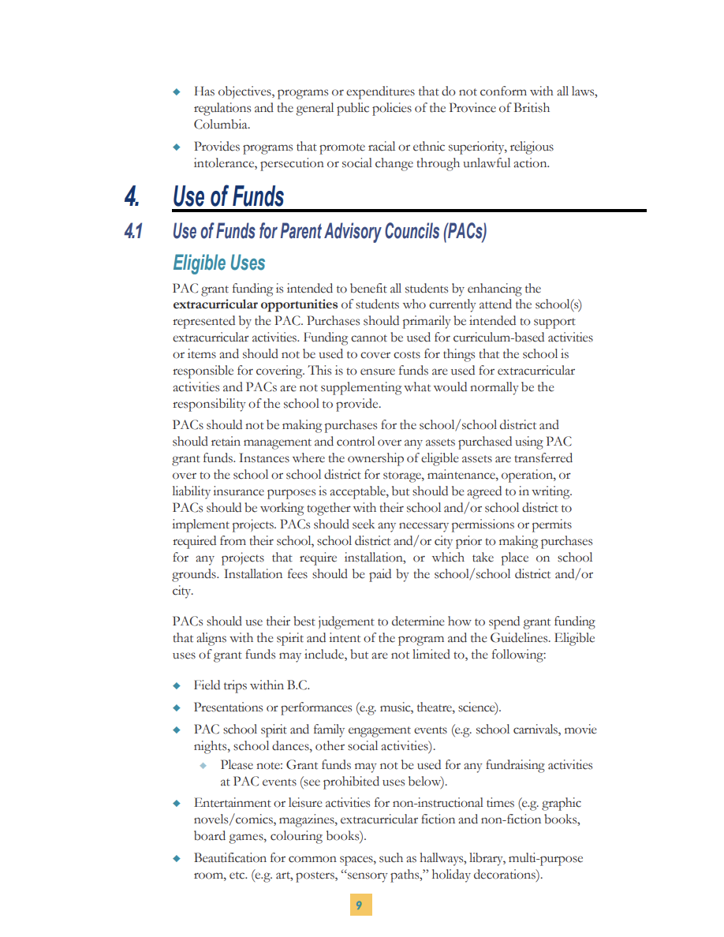
Some Eligible Expenses - PACs
Uniforms and Equipment for extracurricular sports and clubs.
Student recognition (e.g. certificates, trophies, grad memorabilia). Student ceremonies (e.g. graduation, dry grad).
Fees or travel/accommodation costs incurred to travel to the BCCPAC annual conference
Emergency, safety or earthquake related supplies or equipment that is not ordinarily the responsibility of the school/school district.
With prior approval, student transportation and travel outside of B.C

Slide 9
More Eligible Expenses - PACs
Field trips within B.C.
Presentations or performances (e.g. music, theatre, science).
PAC school spirit and family engagement events (e.g. school carnivals, movie nights, school dances, other social activities).
Entertainment or leisure activities for non-instructional times (e.g. graphic novels/comics, board games, colouring books).
Student clubs or societies (e.g. drama club, chess club).

Slide 10
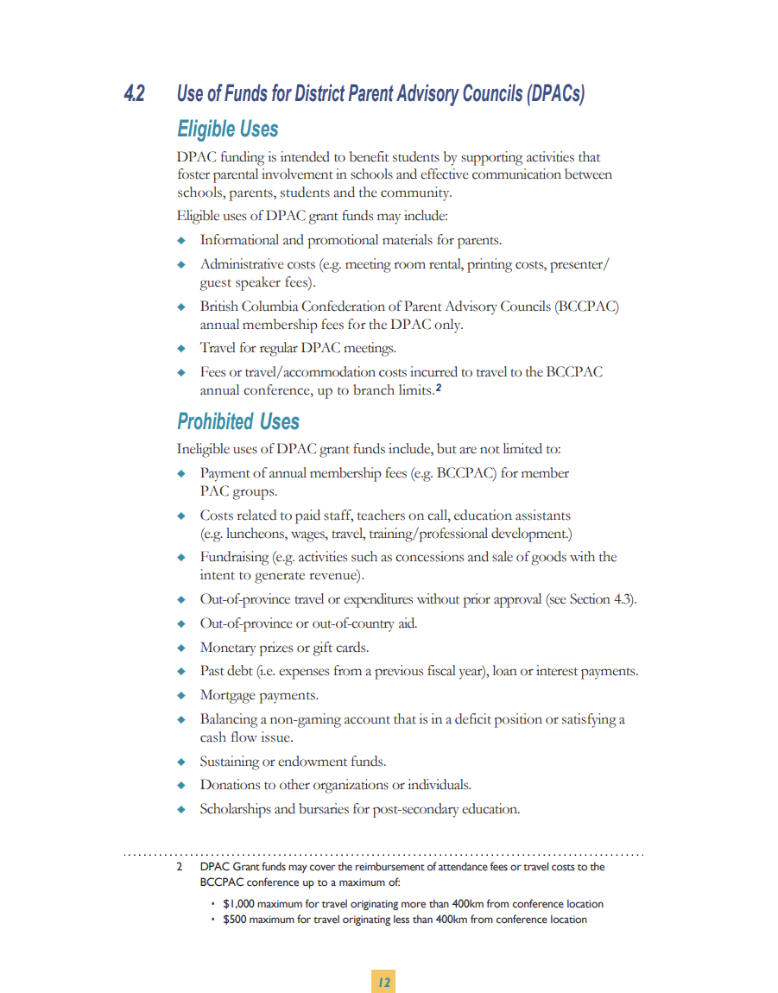
Some Eligible Expenses - DPAC
Informational and promotional materials for parents (e.g. newsletters, websites, social media, etc.)
Administrative costs (e.g. meeting room rental, printing costs, presenter/guest speaker fees, etc.).
Parent training and workshops (e.g. Foodsafe, student health or wellness classes, Robert’s Rules for Boards, etc.)
British Columbia Confederation of Parent Advisory Councils membership fees for the DPAC only.

Slide 11
Ineligible Expenses – PAC/DPAC
Curricular activities or items (e.g. instructional materials, textbooks.
Items used primarily in the classroom to assist in the delivery or completion of curriculum (e.g. tablets, smart boards).
Grant funds may not be used for any fundraising components at PAC events (e.g. the sale of goods/services to generate revenue).
Out-of-province travel, unless approved by the Branch.
Replacing/repairing school facilities that are the responsibility of the school/school district (e.g. structural repairs, water refill stations, school infrastructure).

Slide 12
More Ineligible Expenses – PAC/DPAC
Items that are the responsibility of the school/school district (e.g. audio-visual equipment, PPE).
(PACs-only): Goods and services that benefit the parents (e.g. parent education, parent workshops).
PAC Administrative and/or operational costs (e.g. office supplies, accounting).
Costs related to paid staff, teachers on call, education assistants (e.g. luncheons, wages, travel, training/professional development).
Monetary prizes or gift cards, financial assistance, scholarships

Slide 13

Spending Timeline
PACs: 24 months of receipt.
DPACs: 12 months of receipt.
Grant funds can back-pay expenses incurred in the same fiscal year the grant is received.
This is done by transferring funds from the Gaming Account to the General Account for previously incurred eligible expenses. You cannot pay past debt or future costs not yet incurred.

Slide 14

Spending Rules
Grant funds are deposited into an organization’s “Gaming Account”
All eligible expenses should be paid directly from the Gaming Account. Grant funds may be from the Gaming Account to the General Account for the reimbursement of eligible program expenses.
Method of payment - Cheque or board-approved electronic transfer.
Invoices and receipts must be retained for five years.

Slide 15
Financial Reporting
All Gaming Grant spending must be reported in the “Gaming Account Summary Report (GASR)
All organizations that receive Community Gaming Grants or have previously received a grant and still have money in their Gaming Account, must submit a GASR.
Must be submitted within 90 days of the organization’s fiscal year end (do not submit prior to FYE)
GASR also requires a description of how the funding benefited the community – ie. students.

Slide 16
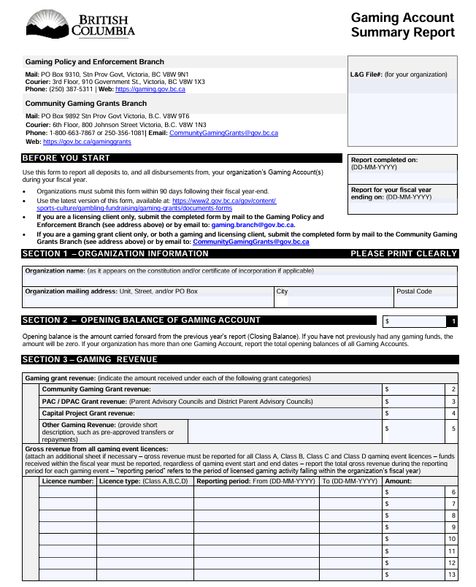
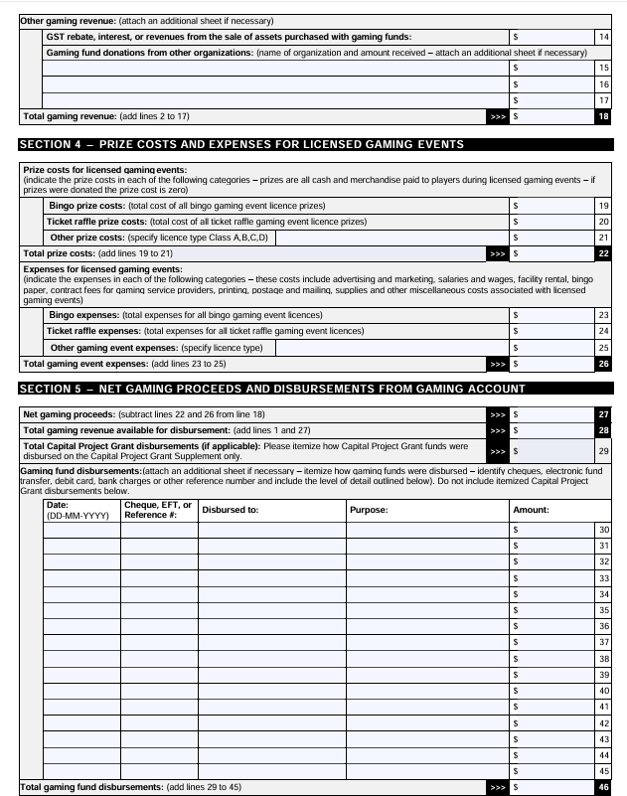
Sample Gaming Account Summary Report

Slide 17
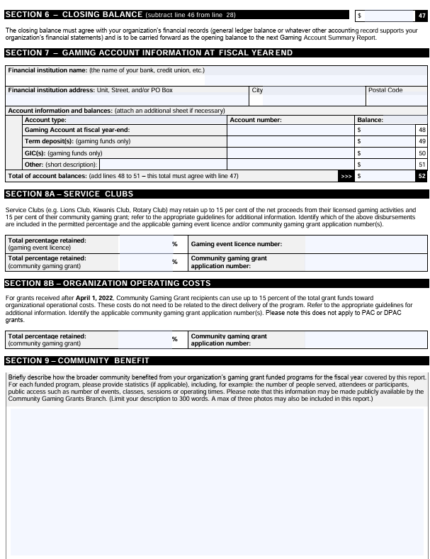
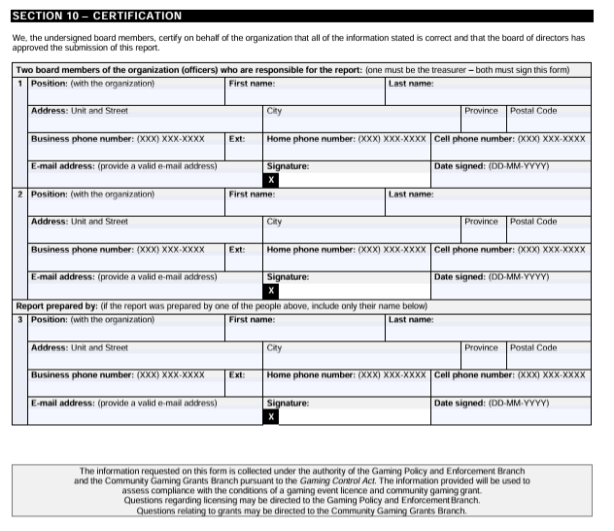
Sample Gaming Account Summary Report

Slide 18

Capital Project Grant
Capital projects with a total cost between $20,000 - $1,250,000
Between 20% and 50% of the total cost of a project may be funded Grants up to $250,000 (max); Matching funds are required
Competitive Process
Application intake period June – August; Notifications: December 31
You can still apply for your Community Gaming Grant

Slide 19
Capital Project Grant Eligibility
Facilities
  Build or renovate buildings (e.g., community facilities, HVAC, lighting, sports facilities)
Community Infrastructure
  Public spaces & amenities (e.g., playgrounds, trails, skate parks, restoration)
Acquisitions
  Long-term assets (e.g., vehicles, equipment, technology)

Slide 20

Gaming Licences
All gambling events require a licence (Class A–D), applied for online before the event
Processing time: 10 weeks (A & C) | 10 days (B & D)
License type depends on the event and funds raised; each event needs its own license
All proceeds go into the gaming account and a revenue report is due within 90 days
Running an event without a license risks loss of gaming funds

Slide 21
Key Resources and Contacts
  Community Gaming Grants Branch (CGG)
  • Website: https://gov.bc.ca/gaminggrants • General Questions: communitygaminggrants@gov.bc.ca
  • Phone: 250-356-1081
  Confederation of Parent Advisory Councils (BCCPAC)
  • Website: https ://bccpac.bc.ca/
  • Email: info@bccpac.bc.ca
  British Columbia Association of Charitable Gaming (BCACG)
  • Website: https ://bcacg.com
  • Email: gamingquestions@bcacg .com
  • Chilliwack – Fraser Valley CCGA https://fraservalleyccga.ca/

Slide 22

Frequently Asked Questions
https://www.abbotsforddpac.ca/faq
Tip – try the search
https://www2.gov.bc.ca/assets/gov/sports-recreation-arts-and-culture/gambling/grants/info-faq-pac-dpac.pdf

Slide 23
Questions?
Thank you for serving your PAC!
Contact:
communitygaminggrants@gov.bc.ca

