Slide 1

PAC 101
Understanding PACs, DPACs, and BCCPAC
dpac.sd34@gmail.com

Slide 2
Agenda
Introductions
Website
PAC Basics
Secretary 101
Treasurer 101
Gaming Grants 101
Special Education Committee
Open Floor

Slide 3

Introductions
Name
School and/or PAC position
What are you hoping to learn more about?

Slide 4
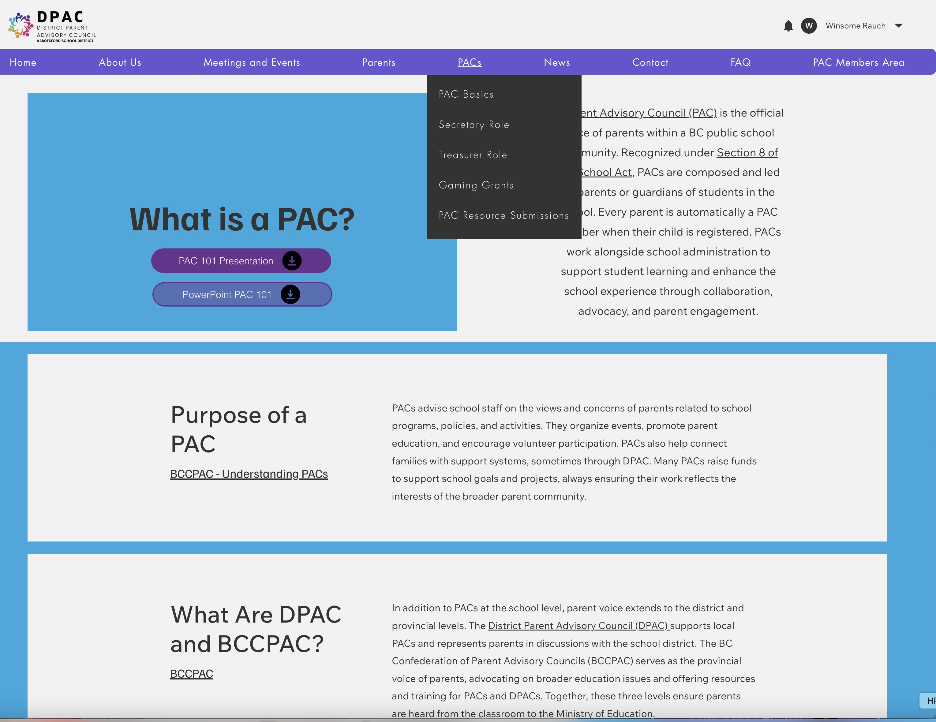
https://www.abbotsforddpac.ca/pacs

Slide 5
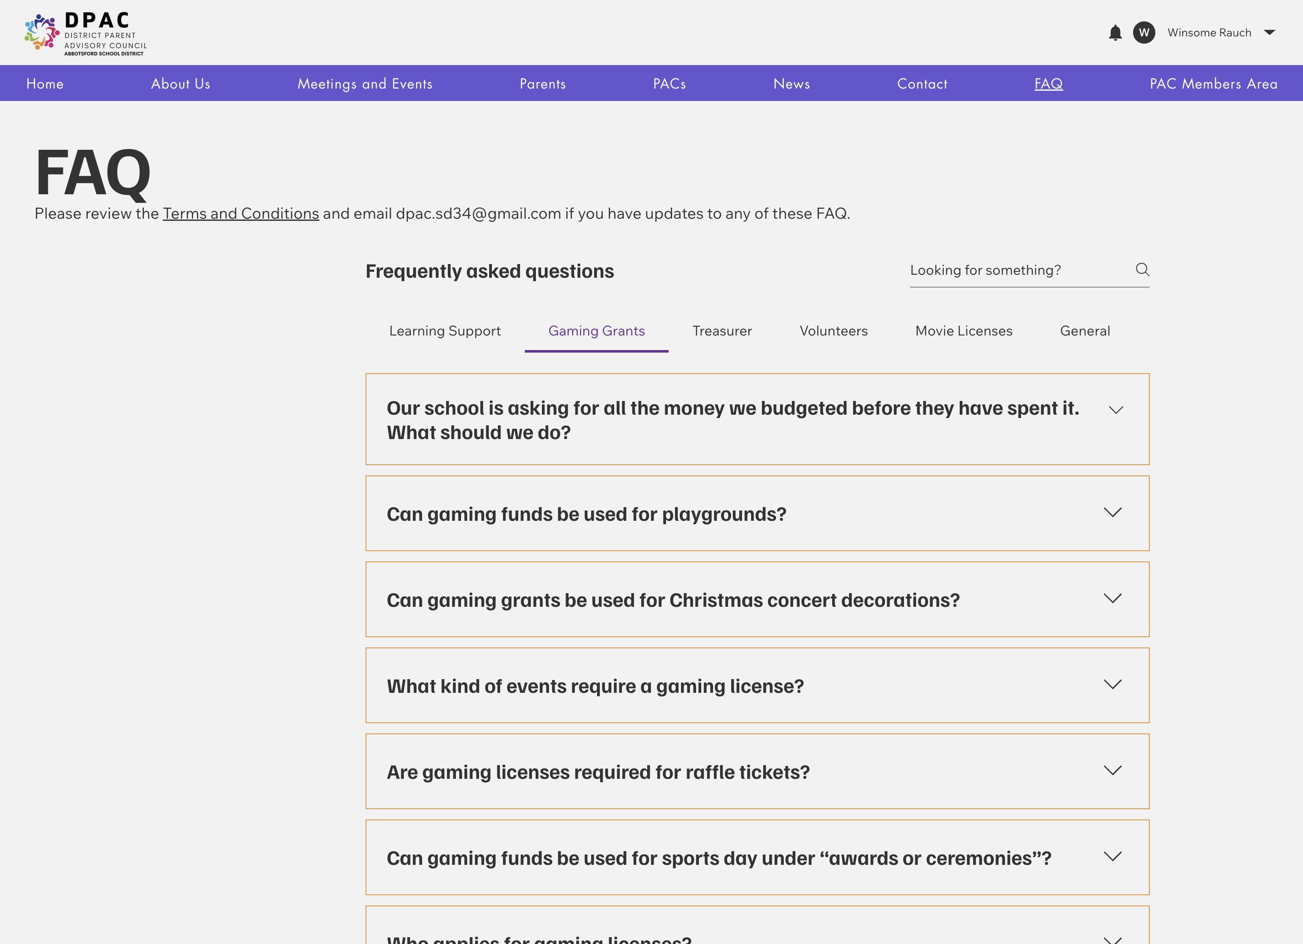
https://www.abbotsforddpac.ca/faq

Slide 6
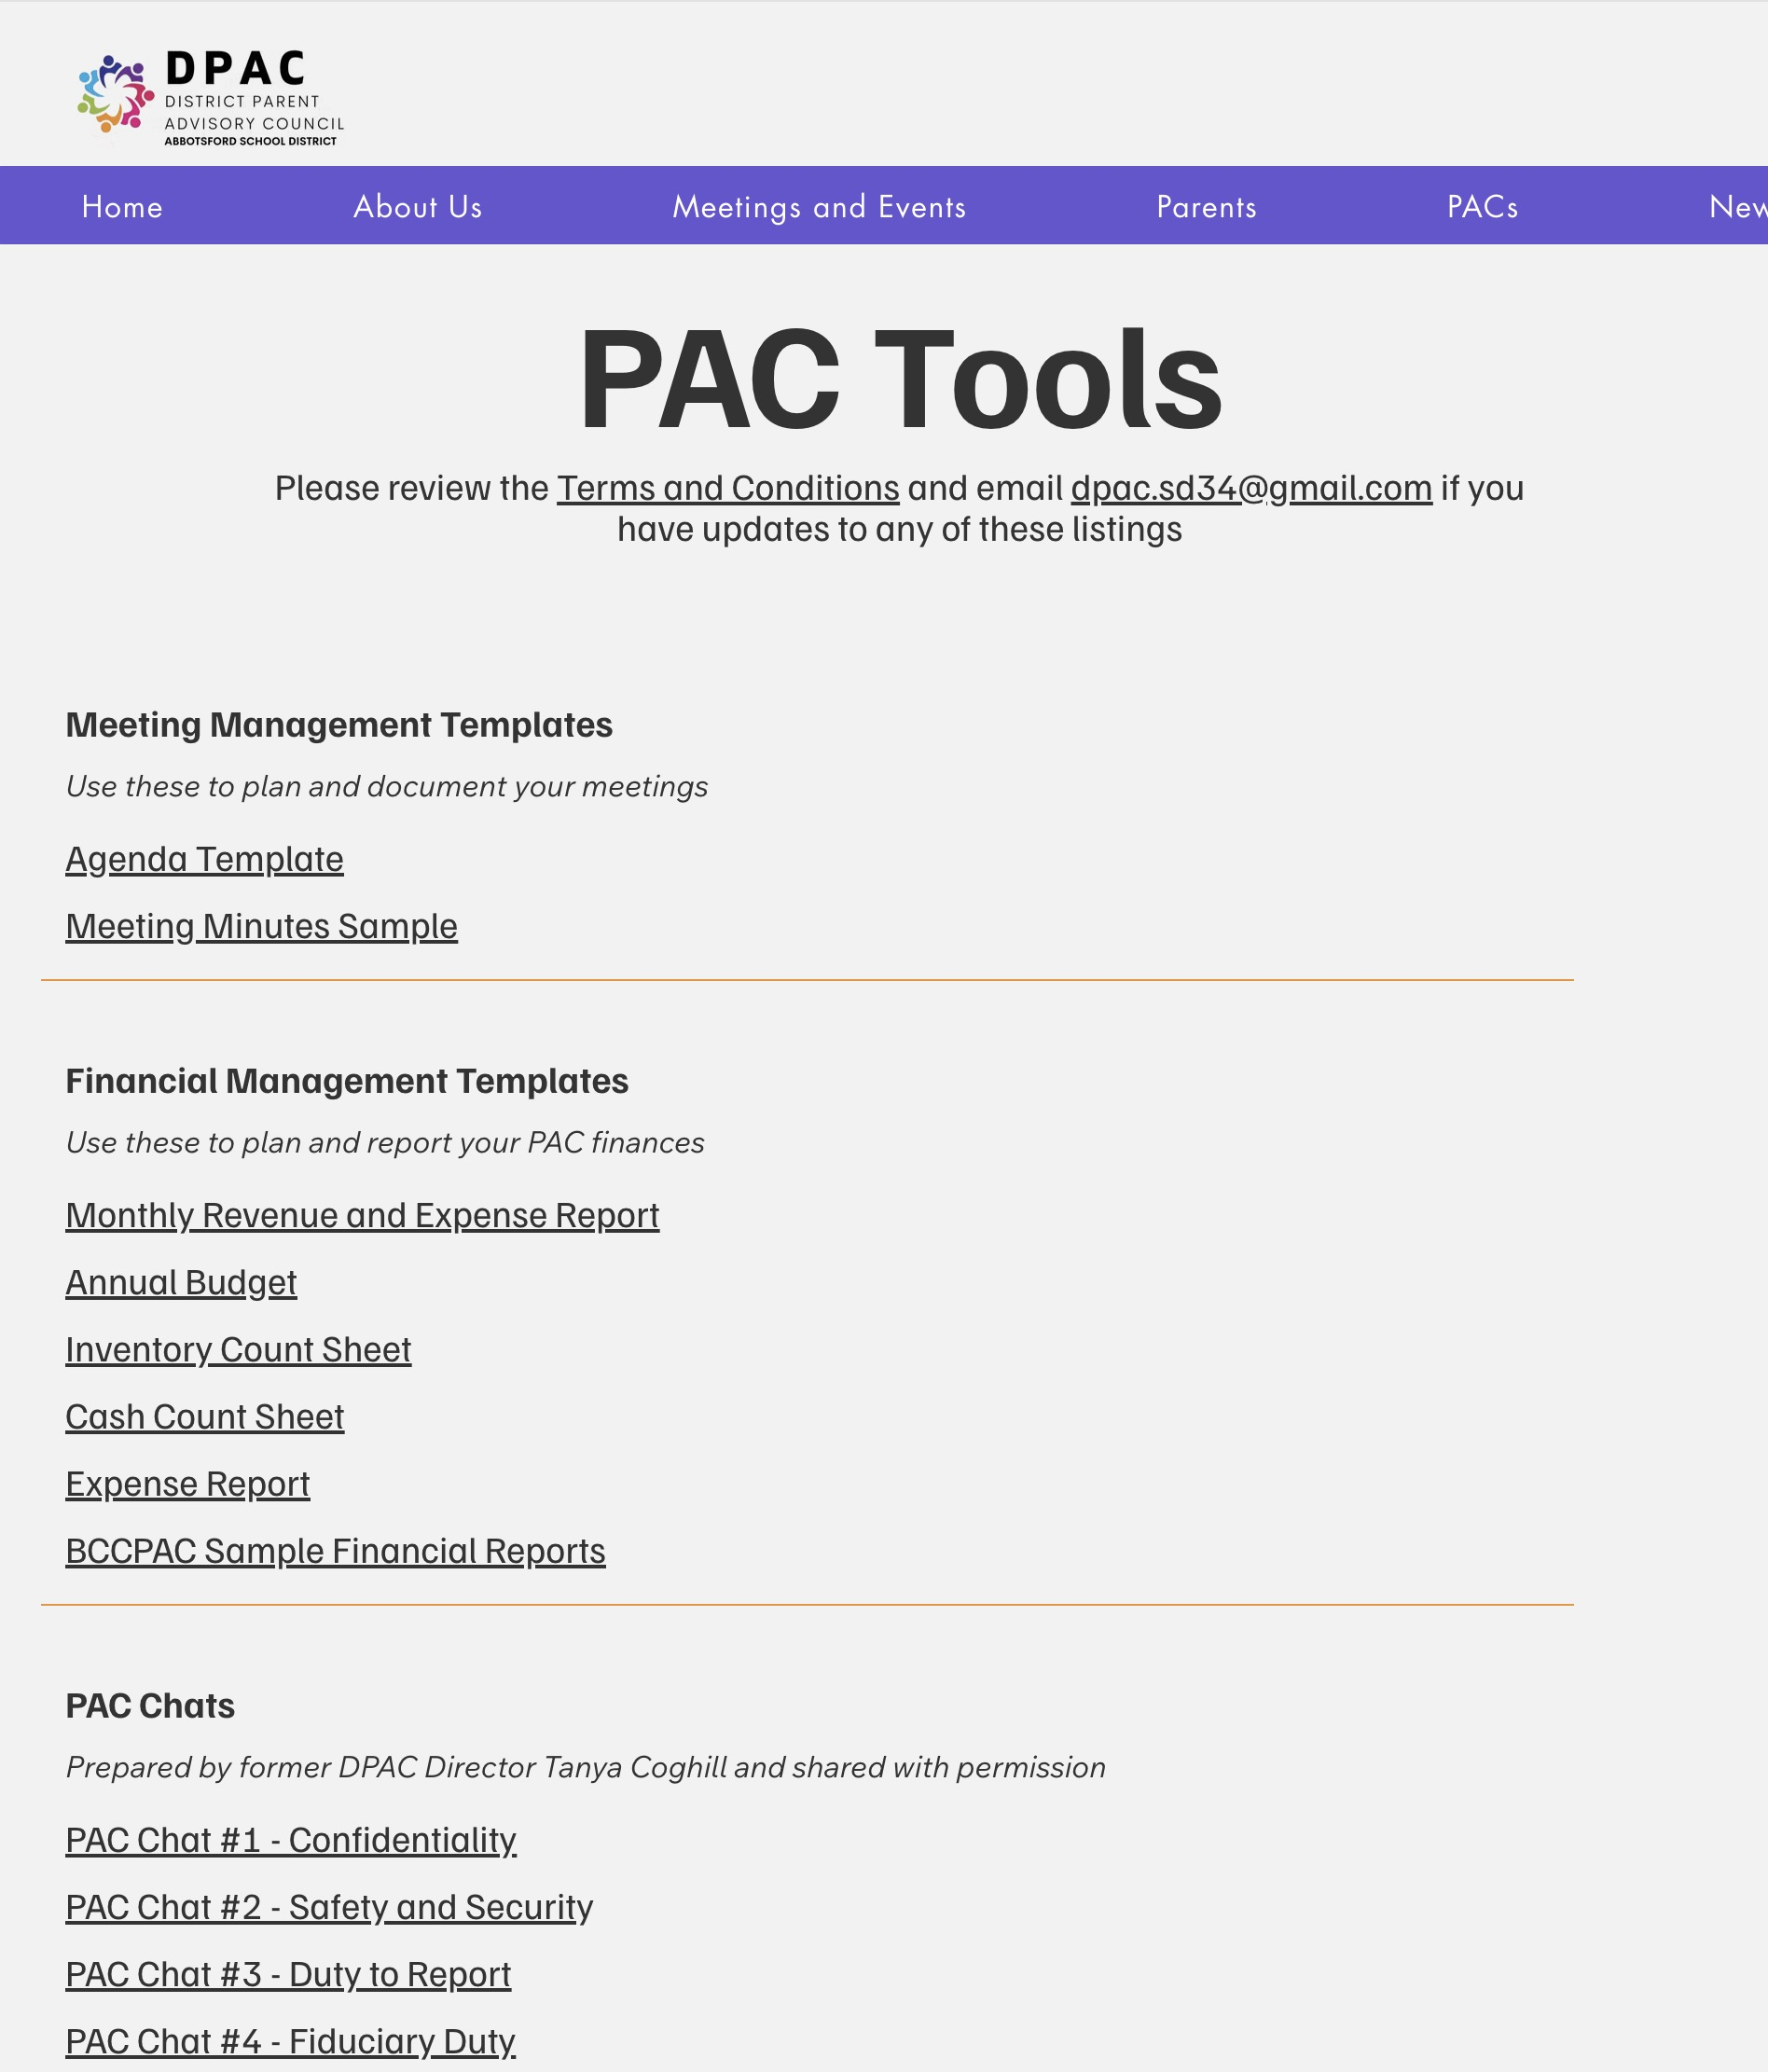
https://www.abbotsforddpac.ca/pactools

Slide 7
What Are PAC, DPAC, and BCCPAC?
PAC: Advises school administration & supports parents
DPAC: Advises the school district & supports PACs
BCCPAC: Provincial voice of parents; supports PACs and DPACs
School Administration
School District
Ministry of Education and Childcare

Slide 8
What Is a PAC?
Recognized under School Act, Section 8
Self-governing with required Bylaws
Official collective voice of parents
Run by parents for parents
Membership is automatic
Not a forum for individual issues

Slide 9
Purpose of a PAC
Advise
Advise school staff on parent feedback
Organize
Organize activities and provide education
Encourage
Encourage parent involvement
Advocate and connect
Advocate and connect parents to supports
Communicate and build
Communicate and build home-school cooperation
Provide
Provide financial support for PAC goals
DPAC Participation
Participate in DPAC activities

Slide 10
Constitution & Bylaws – What and Why?
Required by School Act
Bylaws = rules for meetings, elections, operations
Constitution = purpose and guiding principles
Post publicly (PDF recommended)
Keep accessible and review annually
Every school should have their PAC C&B posted on the school website

Slide 11
Constitution vs. Bylaws
Constitution: Defines why the PAC exists; brief (1–2 pages)
Bylaws: Define how the PAC operates
Roles, elections, accountability
Old bylaws are still valid until changed

Slide 12
Updating Your Constitution & Bylaws
Belong to all members, not just executive
Membership must be involved in updates
Review may take months
DPAC can help

Slide 13
Meetings & Robert’s Rules
Stay focused and respectful
Chair and agenda keep things on track
Robert’s Rules = fair, structured decision-making
Modify if needed (unless Bylaws say otherwise)

Slide 14
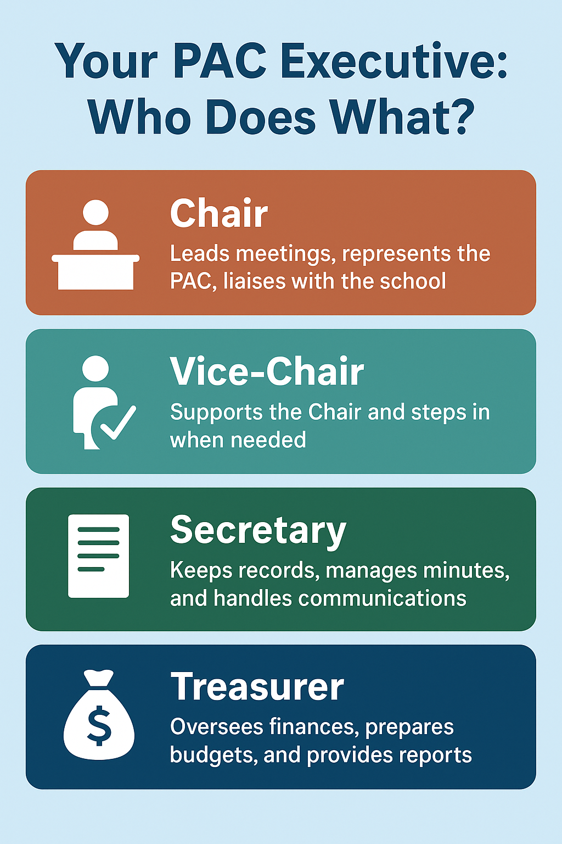
Executive Positions in a PAC
Chair
Vice Chair
Secretary
Treasurer
Other positions as decided

Slide 15
Committee Representatives
DPAC Rep
Hot Lunch Coordinator
Fundraising Coordinator
Book Fair Coordinator
Grade 5 Coordinator
Other roles as needed
Often not part of the executive but it depends on your bylaws

Slide 16
Role of the Chair
Official spokesperson
Preside over meetings
Prepare agendas
Consult and represent PAC
Appoint committees
Ensure PAC’s goals are met

Slide 17
Role of the Vice Chair
Support the Chair
Step in when Chair is absent
Take on duties as needed

Slide 18
Role of the Secretary
Notify members of meetings
Record and store minutes
Maintain Constitution & Bylaws
Handle correspondence
Organize records

Slide 19
Role of the Treasurer
Account for all PAC funds
Report on income and expenses
Maintain proper records
Disburse funds with approval
Prepare annual budget
Share records when requested

Slide 20
Questions?
dpac.sd34@gmail.com
We’re here to support your PAC journey!

